Slide 1
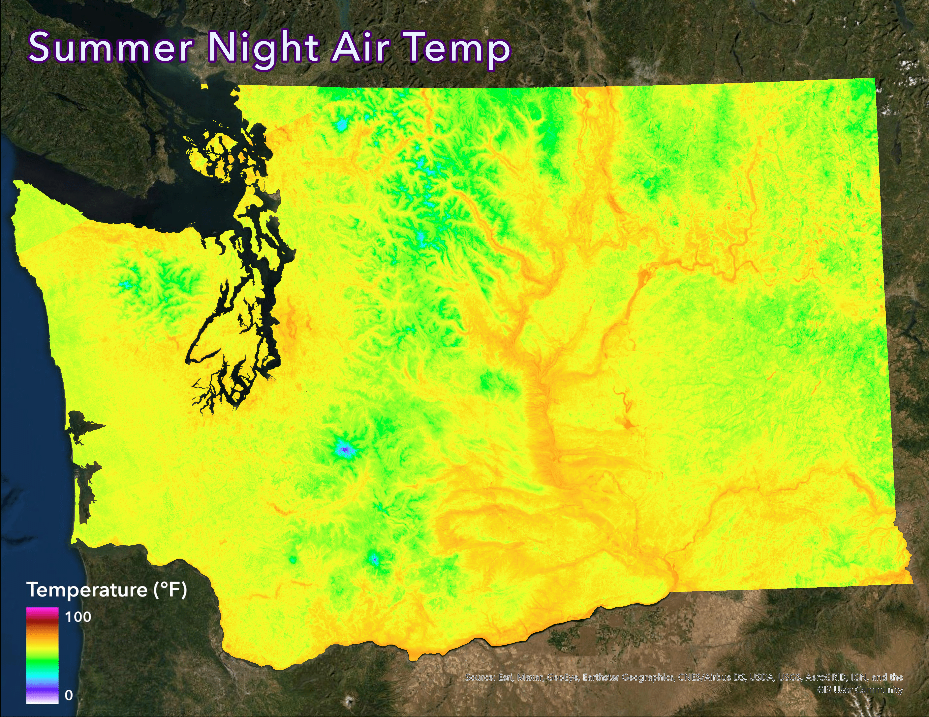
Pinpointing land and surface air temperature variability across topographies in Washington via spatial joining of spaceborne and terrestrial data
Eric Anderson
August 8th, 2021
MGST @ UW-Tacoma
1

Slide 2
Abstract
It is known that different land surfaces have different thermal characteristics.
Is air temperature greatly influenced by topography?
Is local topography considered when making meteorological reports or when conducting climate change studies?
Derive air temperature from land surface temperature.
“…as if there were weather stations every 70 meters across the entire state.”
2

Slide 3
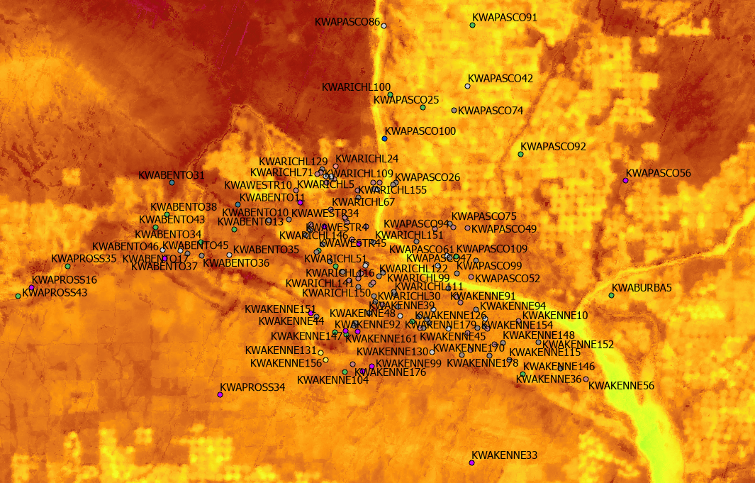
Abstract (cont.)
Measure the degree to which season, land cover type, shadow, and sun altitude displace land surface temperature from air temperature.
Each permutation gets a “penalty” – a correction from land to air, to convert a surface temperature grid to an “air temperature” grid.
Spatial joining of weather stations (terrestrial) and satellite data (spaceborne) from June 2020 – June 2021.
Map season to season to pinpoint hot/cold spots (outliers), discuss where they most frequently appear, extrapolate how.
3

Slide 4
Introduction
Remote sensing of the TIR (thermal infrared) band using ECOSTRESS combined with ‘on-the-ground’ measurements from Weather Underground.
Continuous vs discrete data.
Bridge the gap between temporal and spatial resolutions.
ECOSTRESS: 36-hr everywhere; WU: 5-min virtually nowhere.
Find the most skewed surface air temperatures from those reported by nearby weather stations (dubbed “hot” and “cold” spots), and the spatial-temporal correlations for their skew.
Another angle to assess and predict local temperature patterns.
4

Slide 5
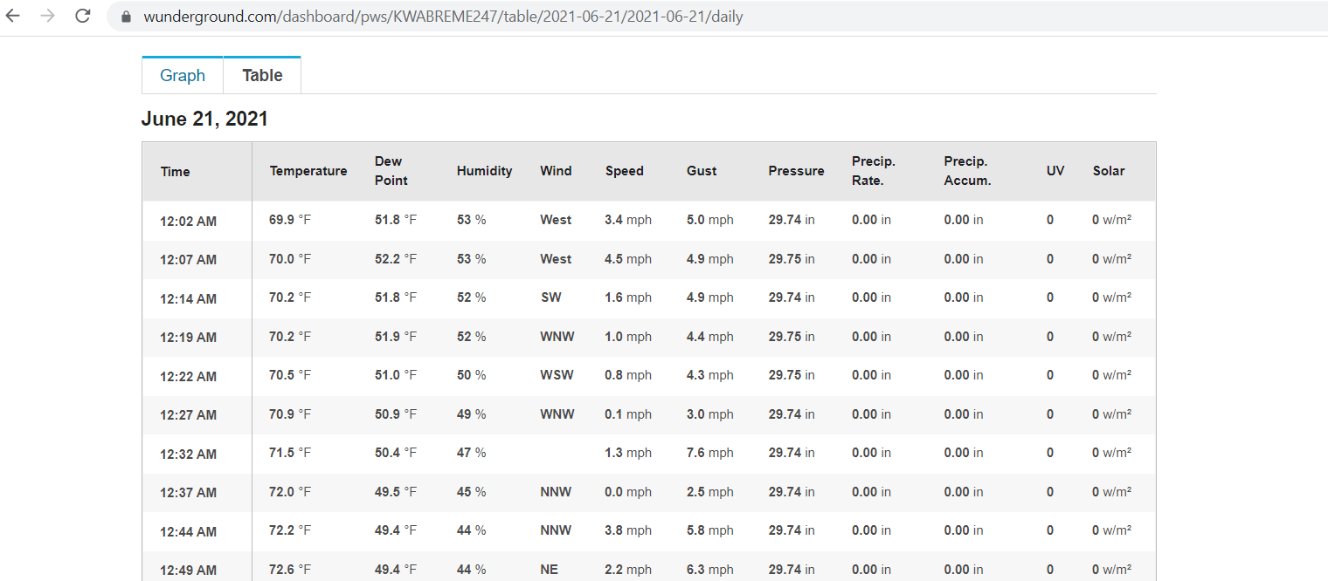
Methods
1.) Web Harvesting in R and Preliminary Data Processing
Acquire online Wunderground stations.
Systematically iterate through known WA cities, check if historical data existed.
Over 15,000 recorded stations, only 5,323 deemed online, only 4,767 with data.
Get/Prepare 1,200 ECOSTRESS links (flybys) from NASA Earthdata for analysis.
Publicly available Python program to georeference the data into .tiff files.
Tiger/Line shapefile data
5

Slide 6
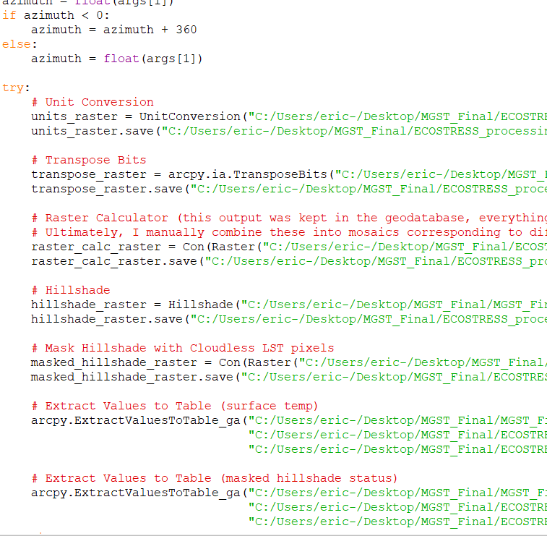
Methods
2.) Automated Geospatial Analysis in Python
For each ECOSTRESS flyby:
Hillshade is calculated based on solar azimuth/zenith.
Reclassify LST pixels to nullify cloud interference.
Weather stations within the extent of a .tiff file have historical air temperature data at the time of ECOSTRESS flyover harvested from the Wunderground website.
CSV file with all metadata is exported.
Temperature penalties (LST minus SAT) calculated.
Sun altitude calculated in R at the very end.
6

Slide 7
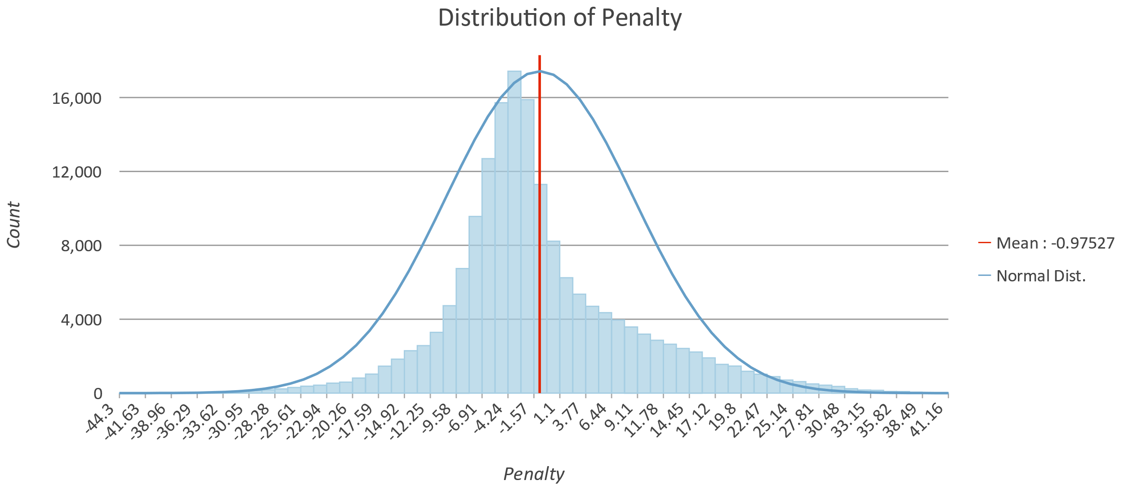
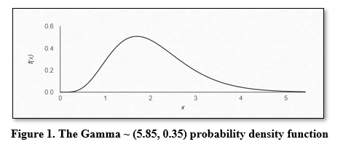
Methods
3.) Data Validation in R
Outlier removal:
Box-Cox power transform to normalize data as best as possible (achieved Gamma distribution)
Remove outliers using Cook’s Distance threshold.
179,623 -> 171,697 observations
Bagging (bootstrap aggregating):
Variance reduction
Ensuring the results reflect what should happen if implemented in reality
1,000 bootstraps, replaced original penalties bootstrapped penalties
7

Slide 8
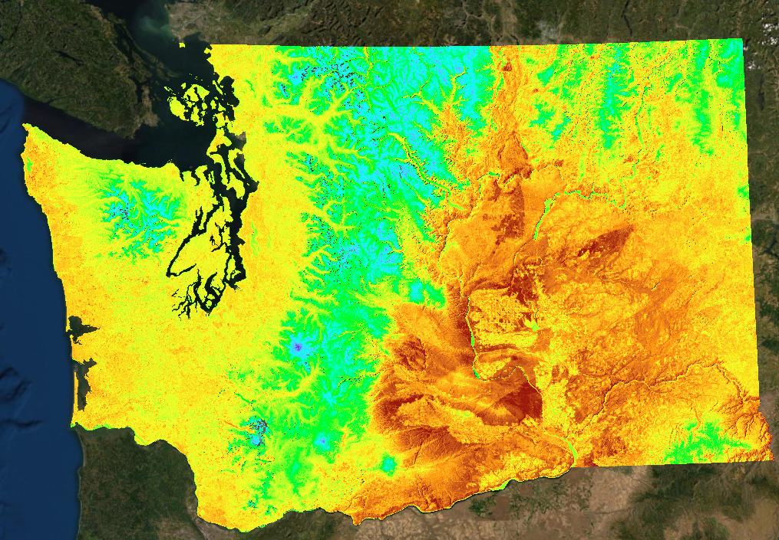
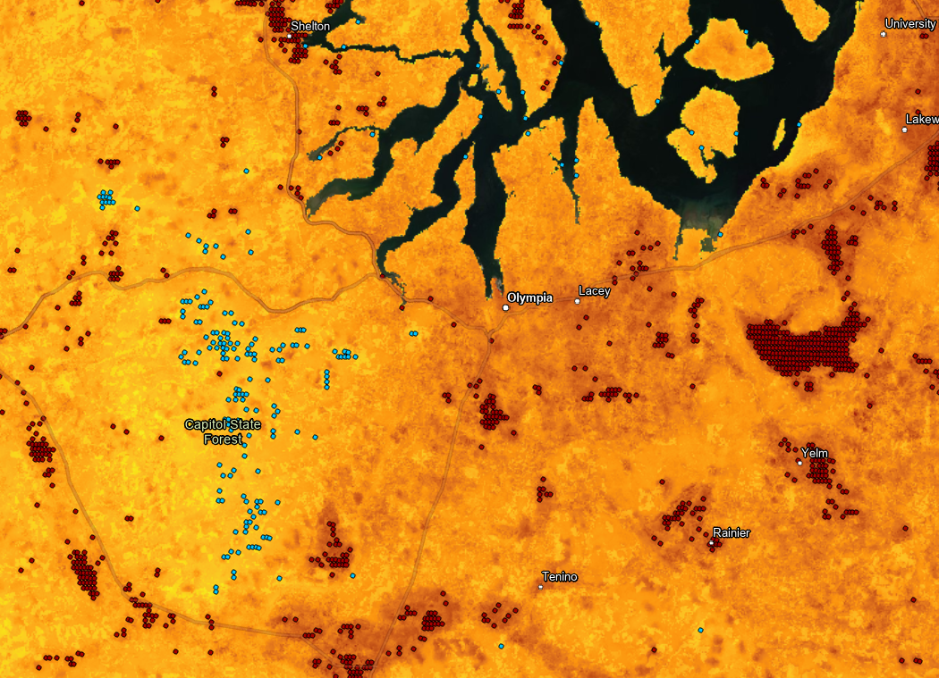
Methods
4.) Data Visualization for Climate Discussion
All rasters mosaicked by variable permutation (“Season_Shadow_SunAltitude”).
Penalties applied to get air temperature grid
Spatial autocorrelation (Getis-Ord Gi* Hot Spot Analysis)
Assigns z-scores based on the feature’s proximity to clusters of high or low temperatures
Ignored areas greater than 1,000 meters
Spring No Shade Late Morning (30°- 45° Sun Altitude)
Air Temperature Correction!
8
Hot Cold Spots near Olympia, WA

Slide 9
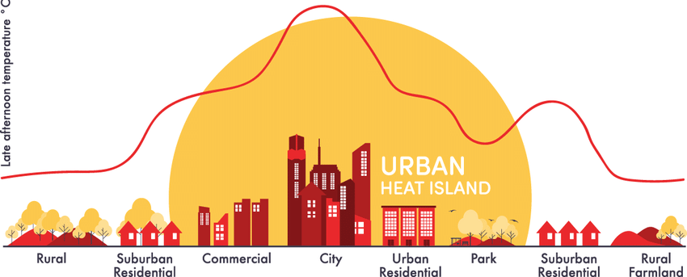
Literature Review
The Urban Heat Island (UHI) Effect
High thermal radiation in urban areas compared to outlying cooler rural regions.
Urban land absorbs solar radiation, does not reflect (pollution makes this worse).
An obvious example of localized temperature variation independent of meteorological patterns.
Goal: minimize absorption of solar radiation by creating low albedo surfaces.
Paint surfaces white, strategically place vegetation.
9

Slide 10
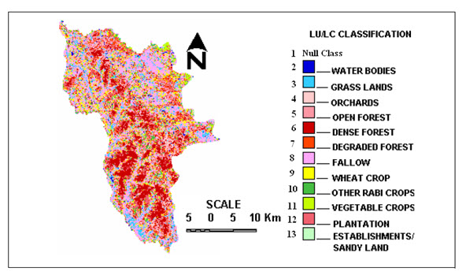
Literature Review
Land Use Land Cover (LULC) Classification
Assigning pixels that exhibit similar spectral characteristics to spectral classes via clustering algorithms.
Land cover predicts countless environmental phenomenon – including albedo.
Used to make policy and judge the success of heat dispersion in urban areas.
Depends on ground-truthing – going out and physically verifying the materials on the Earth's surface.
Misclassification is bad.
10

Slide 11
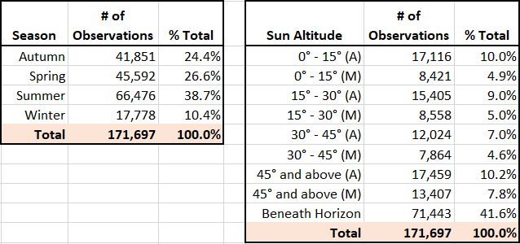
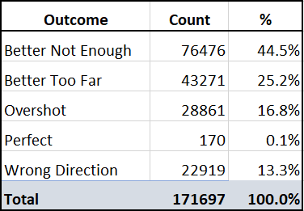
Results
Seasonal Bias:
Warmer months contained fewer clouds.
After penalty correction, the absolute difference between LST and SAT shrunk by 35.7%, with 69.7% of observations reporting a more accurate SAT than before correction.
Better during summer, under a high-altitude sun, and on developed land.
Worst during autumn, under a mid-altitude sun, generally in high vegetation areas.
11

Slide 12
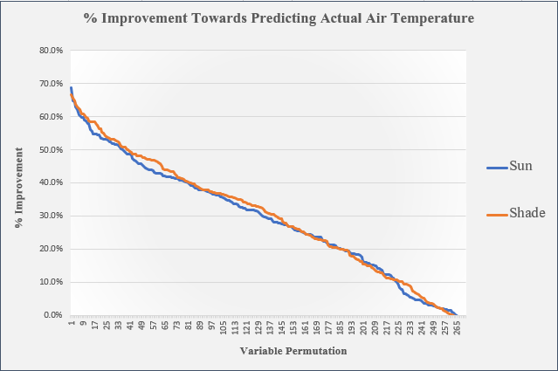
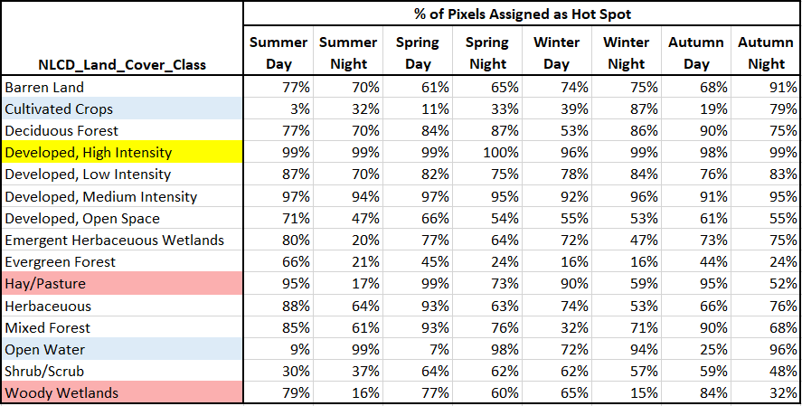
Results
Shadow vs no shadow yielded similar results.
Confirmed with two-sample comparison (t-test).
Either an indication that shadow does not significantly predict a landmark’s air temperature, or bad data.
Hot Spot Distribution by Land Cover Type
Developed lands are always hot.
Some land is relatively warmer at night.
12

Slide 13
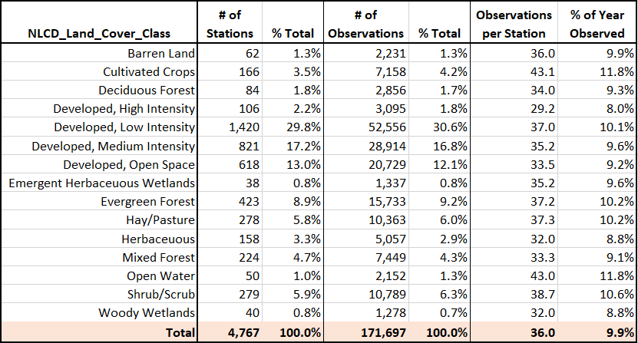
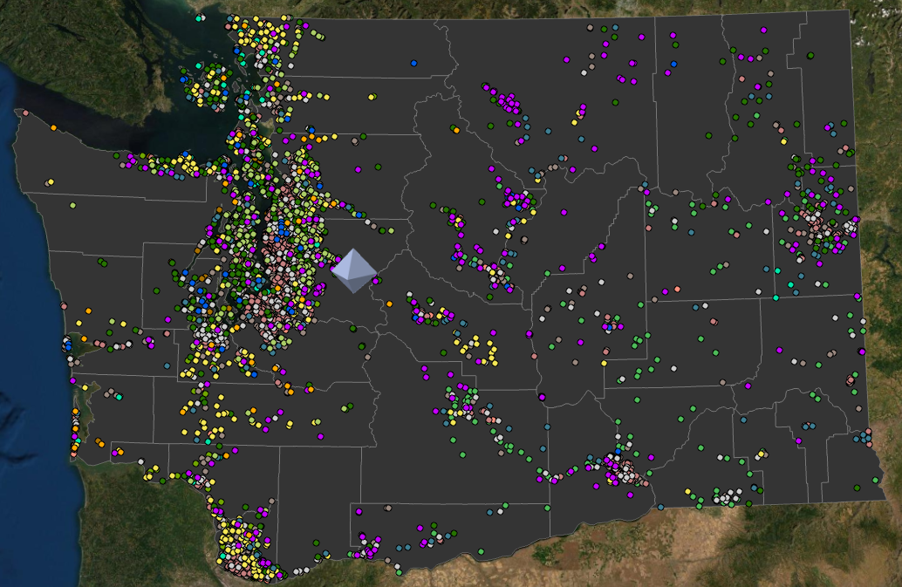
Results
Skewed distribution of ground weather stations (~60% in a developed area).
Over-emphasizing the urban phenomena?
Could warrant a plea for future research.
13

Slide 14
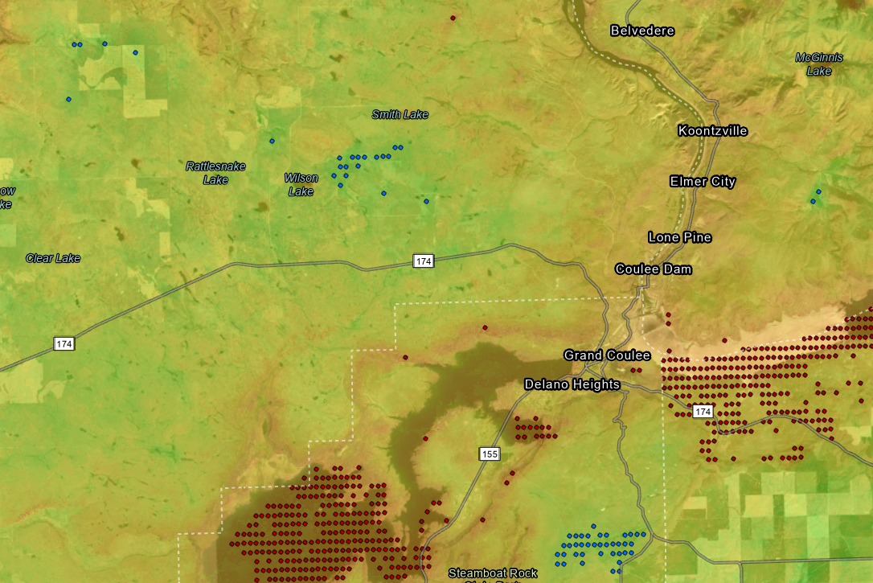
Results
One example of temperature variations in a confined region:
Summer at Night, Air Temp
Near Grand Coulee Dam
14

Slide 15
Application/Intervention
Code Repository
GIF Timelapses
Web Map in ArcGIS Online
15

Slide 16
Discussion
Important to reiterate that these results only apply to cloudless skies.
Atmospheric noise is a grave disadvantage of remote sensing in general.
Air Temperature patterns still mimic Land Surface Temperature patterns.
A positive correction was made, but not far enough?
How to humanly verify?
More accurate results by accounting for other atmospheric effects, like humidity and wind.
Heat index vs raw temperature.
Temporality still something to overcome.
Replicate this project with a courser satellite (e.g. MODIS) for more constant coverage.
Knowledge of these corrections may enable future researchers to model temperature when localized data is unavailable.
16

Slide 17
Questions or Comments?
ermian98@uw.edu
17

